Slide 1
Employee Data Analysis using Excel
STUDENT NAME: PAVITHRA.Y
REGISTER NO: 312216796
NM ID( Username): 632B4BC79F532E3ADFF48D1B1F8BEC27
DEPARTMENT: BCOM(Accounting & Finance)
COLLEGE: SHRI KRISHNASWAMY COLLEGE FOR WOMEN

Slide 2

PROJECT TITLE
Employee Salary Analysis using Excel

Slide 3


AGENDA
Problem Statement
Project Overview
End Users
Our Solution and Proposition
Dataset Description
Modelling Approach
Results and Discussion
Conclusion
3/21/2024 Annual Review

Slide 4

PROBLEM STATEMENT
Salary analysis, also known as compensation analysis, can be important for both employees and organizations
EMPLOYEES:
Salary analysis can help ensure that employees are paid competitively and fairly, both internally and externally. It can also lead to more open discussions about pay and performance, which can motivate employees and increase productivity
ORGANIZATION:
Salary analysis can help organizations understand market trends and salary benchmarks, and identify factors that may contribute to pay inequities. It can also help organizations attract and retain top talent, and establish a competitive edge in the job market. Salary analysis can also help organizations make better decisions about resource allocation, such as investing in training, benefits, and perks

Slide 5

PROJECT OVERVIEW
.
♦A salary analysis project can involve comparing an organization's compensation packages to the market rate for each position. The goal is to determine if any salary adjustments are needed, and to ensure that compensation is fair and attractive to employees
♦Employee Data analysis helps to deduct the salary of the employee considering various factors like Gender, Designation, and further information to deduct the salary analysis in an company
♦Salary analysis is vital to providing fair, equitable compensation. Smart organizations know that providing the right compensation is one of the key pillars to attract and retain the best talent. A thorough compensation analysis provides the data and insights for critical decisions as it relates to salaries and total benefits for employees.

Slide 6
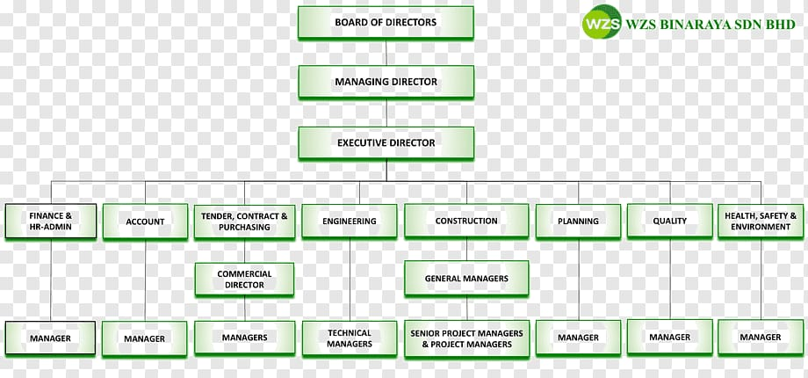

WHO ARE THE END USERS ?

Slide 7

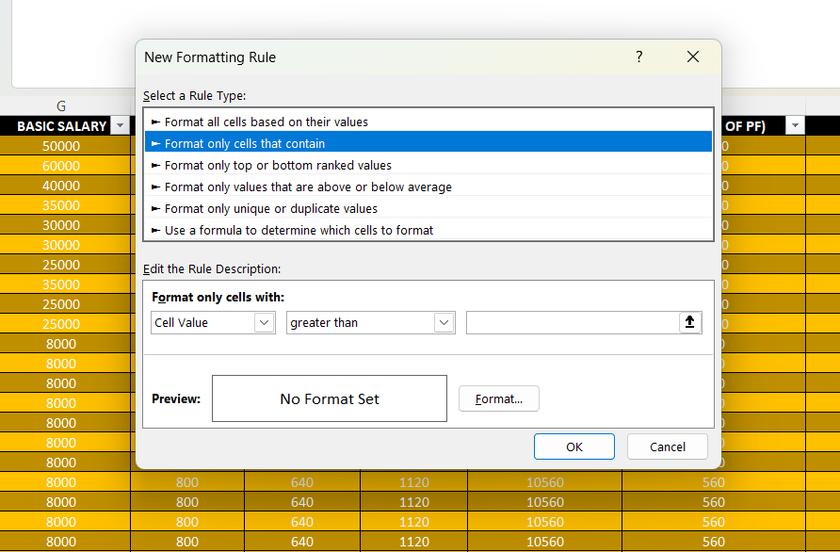
OUR SOLUTION AND ITS VALUE PROPOSITION
1. Conditional Format - At first move to the conditional format table in that select the Highlight cells rules in that we should select the more rules in that it creates an box like this
After this should select the cell value as “blank” and should select format option and fill colours so that the Missing values will not be placed as blank and it would be filled with colours..
2. Filter - As the same the filter option also used to remove the missing values or letters

Slide 8
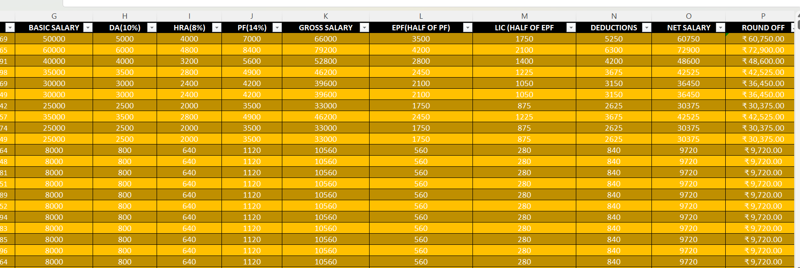
3. Formula – By using the formula method it helps to deduct the salaries of an employees and can calculate the total salary of the employee
4. Pivot Table - Pivot table helps to deduct the employees salary according to their
Performance in an company or organisation and it also helps to allocate the employees data in an single statement
5. Graph - This helps to visualize the total summary which has been made for an statement will be shown graphically as a data in Graph

Slide 9
Dataset Description
■ Employee Dataset Downloaded From- Kaggle
■ It includes 26 Character but in that we have selected only 16 Main character It includes:
■ EMP ID, EMP NAME,DESGINATION
■ GENDER
■ BASIC SALARY, HRA, DA,GROSS SALARY
■ PF, EPF(HALF OF PF) LIC (HALF OF EPF)
■ DEDUCTIIONS AND TOTAL SALARY
■ FORMULAS TO CALCULATE THE %
■ INSERTED A PIVOT TABLE
■ AND INSERTED A SLICER AFTER INSERTING THE PIVOT TABLE
■ AND AFTER THAT INSERTED A CHART OR GRAPH TO REPRESENT THE OUTPUT OF
THE SALARY ANALYSIS OF AN EMPLOYEE

Slide 10

THE "WOW" IN OUR SOLUTION
FORMULAs:
1. DA% : =G3*10/100
2. HRA% : =G11*8/100
3. PF% : =G11*14/100
4. SUM : =SUM(G3:J3)
5. GROSS SALARY : =SUM(G3:J3)
6. EPF(HALF OF PF) : =J4/2
7. LIC (HALF OF EPF) : =L11/2
8. DEDUCTIONS : =SUM(L4:M4)
9. NET SALARY : =K6-N6
10. Inserted the Pivot Table in the excel sheet to find the salary analysis of an employee in an organization
3/21/2024 Annual Review
10

Slide 11
MODELLING
DATA COLLECTION :
The first step is to download the dataset from the Kaggle.
I have downloaded it from the edunet dashboard and pasted in the excel and started to my salary analysis project
FEATURE COLLECTION :
After downloading it from the edunet dashboard I have made the salary analysis as the first step it includes the 26 characteristic column but I have taken an note of 16 characteristic
And I have inserted the format cells which gives and highlights the cells and thus creates and outrated cells in the statement as it shows separately in it
DATA CLEANING :
So, in the cells there might be few cells which contain a blank space so to colour it we use an option called conditional formatting in that we can fill colours at blank space
The second option as it includes the filter it helps to remove the blank space cells fully
11

Slide 12
FORMULAS :
All the formulas has been entered to find the total salary of an employee
SUMMARY :
The summary represents the Pivot table thus it helps to deduct the employees salary according to their
Performance in an company or organisation and it also helps to allocate the employees data in an single statement
CHART :
As it represents the chart or graph in which all my details will be allocated and maintained as an single chart
The chart represents the data visualization of the employer salary analysis according to there performance

Slide 13
RESULTS
13

Slide 14
conclusion
The salary analysis reveals that while our compensation is competitive overall, there are disparities in certain roles and departments that need addressing. To ensure fairness and maintain our competitive edge, we recommend implementing targeted salary adjustments, revising the pay structure for consistency, and enhancing benefits and incentives. Additionally, establishing a regular review process will help us stay aligned with market trends and internal equity. These steps will support our goal of attracting and retaining top talent while promoting a more equitable work environment.

